Slide 1
Online Portfolio Selection
Algorithmic Trading Course Project
Sajay, Srihari, Sudeep

Slide 2
Motivation
What we learned in class:
Generate trading signal for a stock.
Trading signals => When to buy and sell a single asset (+1,1)
But how much of our wealth do we invest? - Bet sizing
But there are 1000s of assets. How to decide allocation to each asset? - Portfolio selection
Need to do this continuously, in an online fashion.

Slide 3
Bet Sizing: Single Stock
Instead of generating buy/sell signals, decide x(t) in [-1,1] at time t.
|x(t)|is the portion of wealth invested. Sign represents long/short.
Appropriate trades are made to go from x(t-1) to x(t)
Similar to the concept of “Kelly Bet Sizing”

Slide 4
Multiple Stocks
There are also 1000s of assets to trade.
So, further generalize to picking portfolio vector x.
Where |x_i| is the portion of wealth invested in stock i.
So OPS picks a portfolio at the beginning of each period.
Buy/Sell trades are automatically made to reach x(t) from x(t-1)

Slide 5
Interaction Protocol
At open, place trades to get portfolio x(1)
………
Get x(3) based on the past
Based on what happened in this window, get portfolio x(2)

Slide 6
Data Acquisition and Preprocessing
We consider strategies that only use Price Information.
We acquire simulated prices using the GBM model.
We acquire real market prices from Yahoo Finance and Refinitive

Slide 7
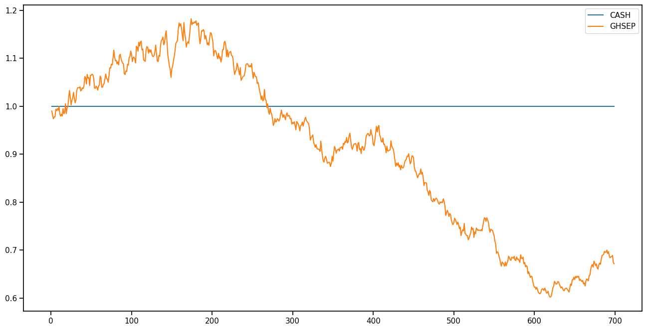
1 asset and cash GBM

Slide 8
Online Portfolio Selection Techniques
Follow-The-Leader
Exponentiated Gradient
Online Newton Step
Passive Aggressive Mean Revision
Online Moving Average Revision

Slide 9
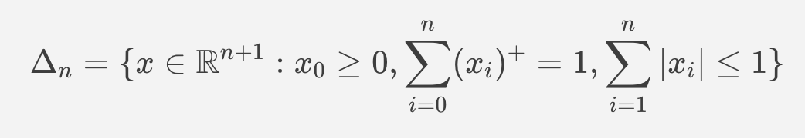
Trading Strategy Development
We run algorithms on intraday data.
Rebalancing portfolios every minute.
We allow shorting.
If we have n assets and cash, the portfolio space with shorting is:

Slide 10
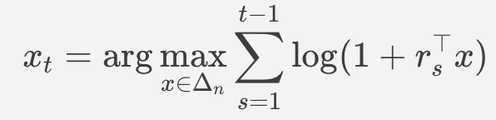
Follow the Leader
At time t, we know the returns from 1 to t-1. So, we optimize:
Here r_s is the return vector

Slide 11
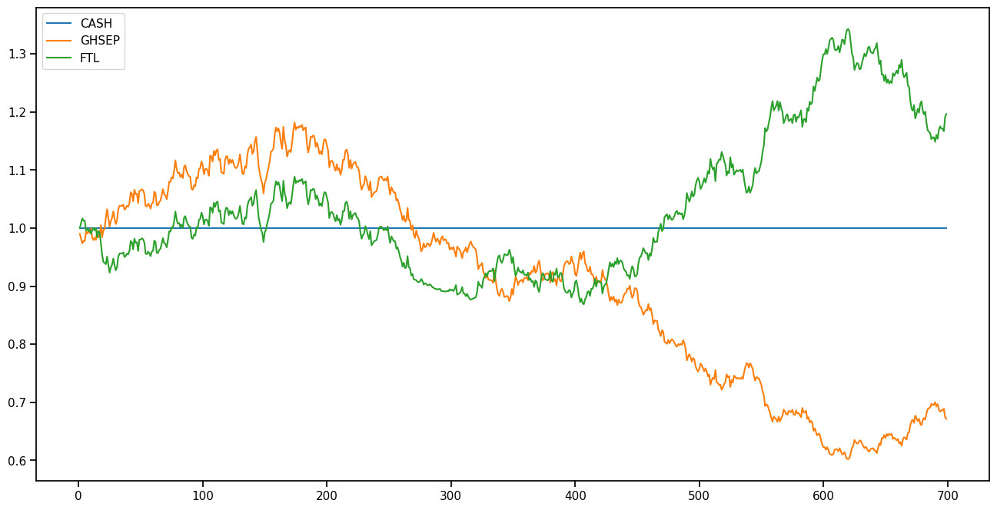
FTL performance

Slide 12
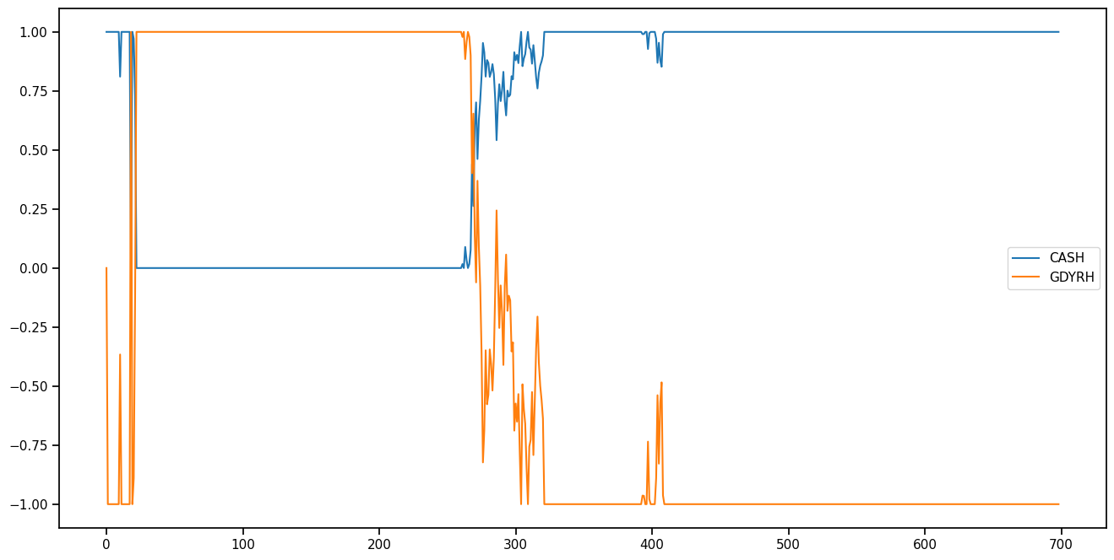
FTL portfolio

Slide 13
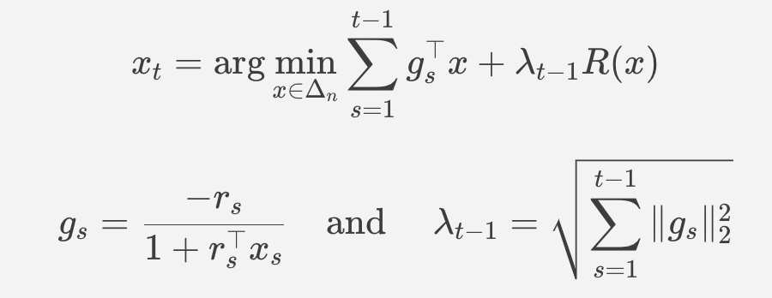
Exponentiated Gradient
Follow the Linearized Leader with Regularization:
There are different choices for R(x) like entropy and 2-norm. The version with entropy is called Exponentiated gradient.

Slide 14
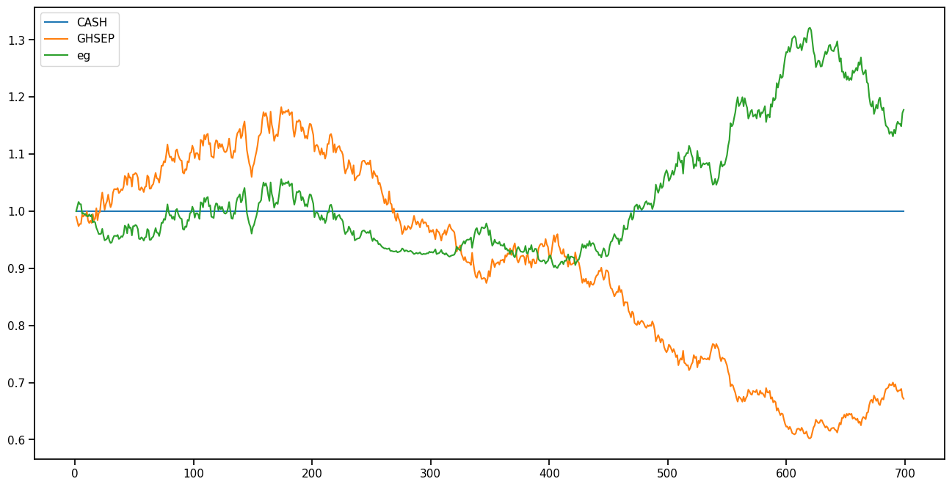
EG performance

Slide 15
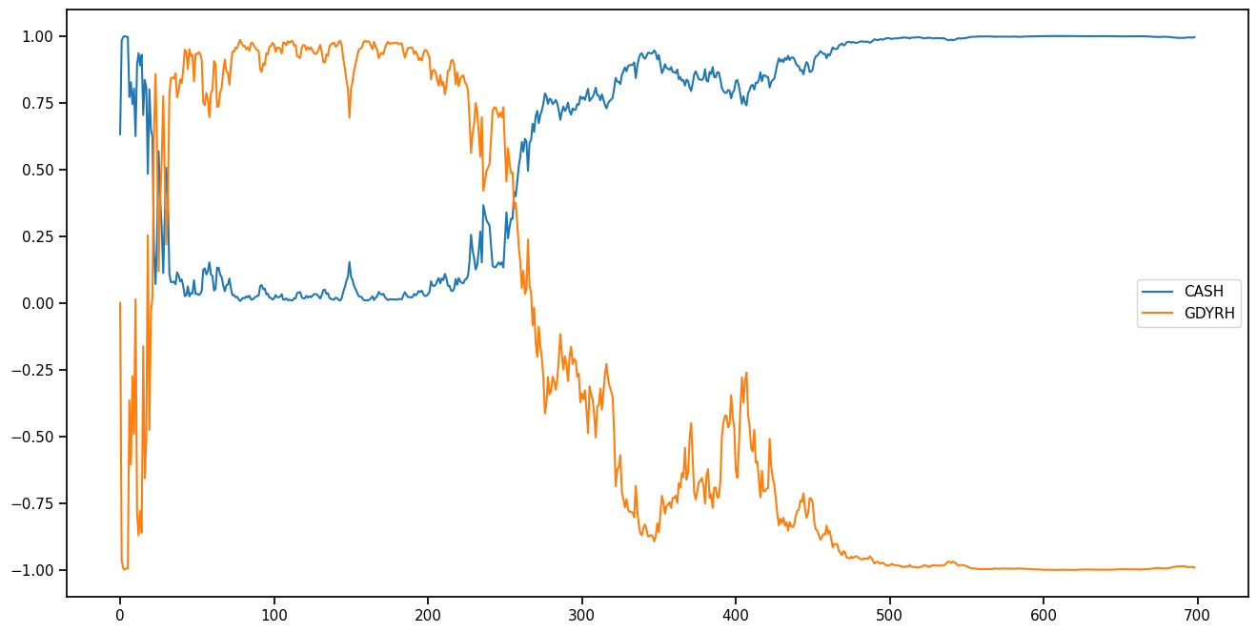
EG portfolio

Slide 16
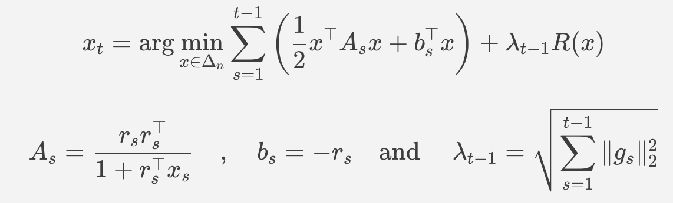
Online Newton Step
Follow the Quadratic Leader with Regularization
There are different choices for R(x) like entropy and 2-norm. The version with 2-norm is called Online Newton Step

Slide 17
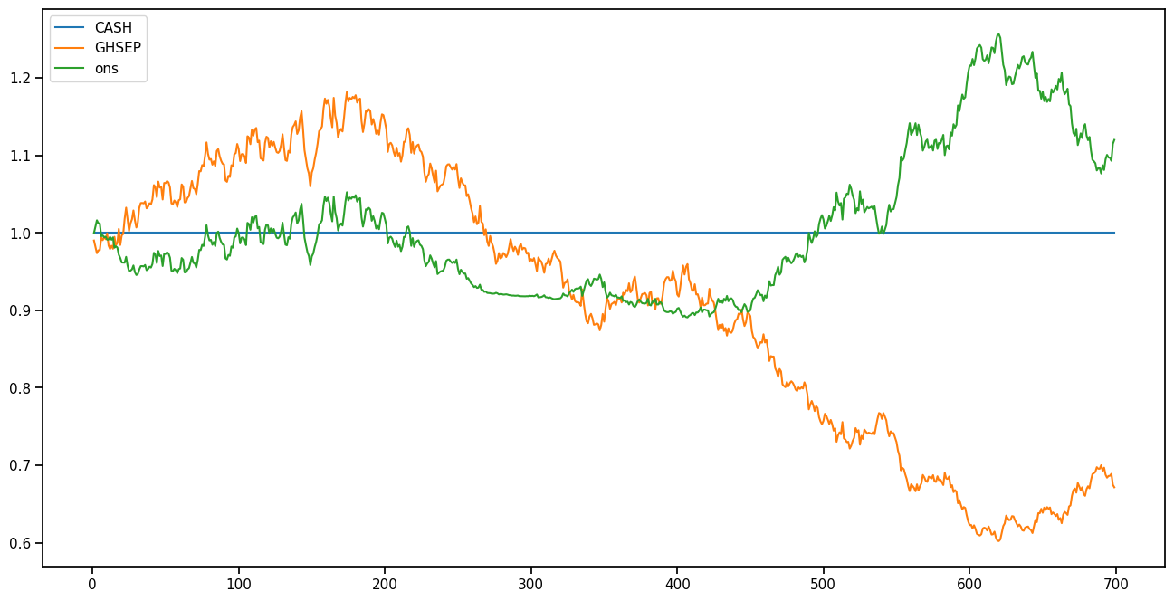
ONS performance

Slide 18
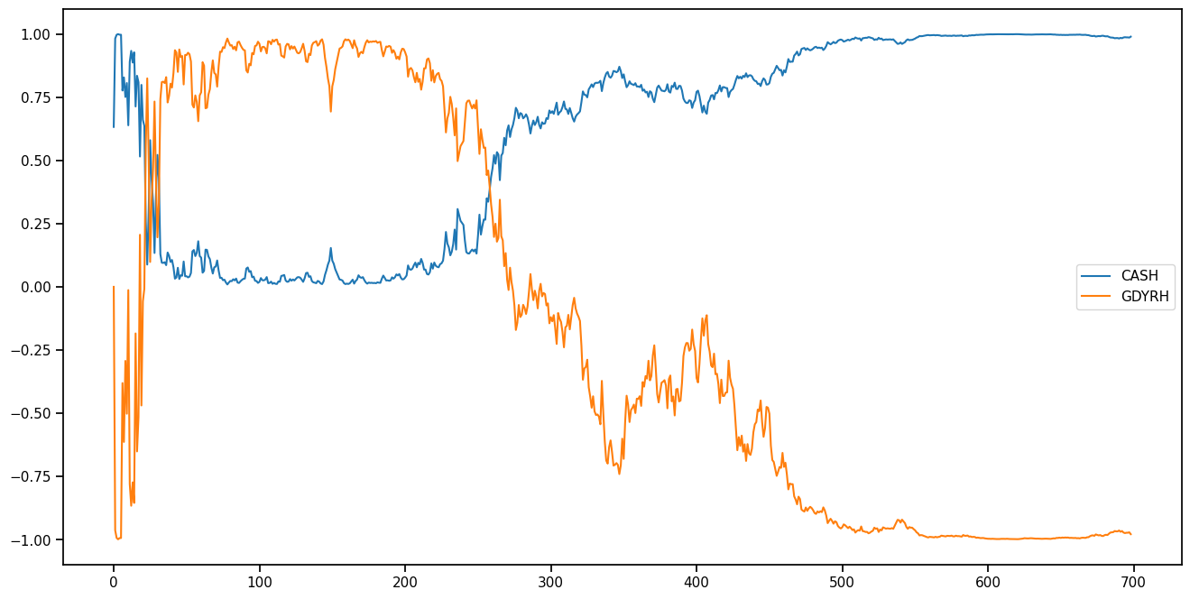
ONS portfolio

Slide 19


Passive Aggressive Mean-Reversion
Ideal Mean Reversion - Short over-performing and long under performing stocks from previous period.
Downfall - If stocks keep on under-performing, you will end keep losing wealth completely
PAMR - If the market drops too much, we would stop actively rebalancing portfolios to avoid certain “mine” stocks
Implementation:
Select ε (Loss threshold).
Initialise weights 1 in cash and 0 in other assets
For each time instant:
if previous portfolio return > ε:
Rebalance portfolio to attain ε loss
Else:
Continue with same portfolio
Loss Function
PAMR
PAMR - 1
PAMR - 2
Notes:
Select a return threshold of how much willing to lose (ε). If previous portfolio makes more than

Slide 20
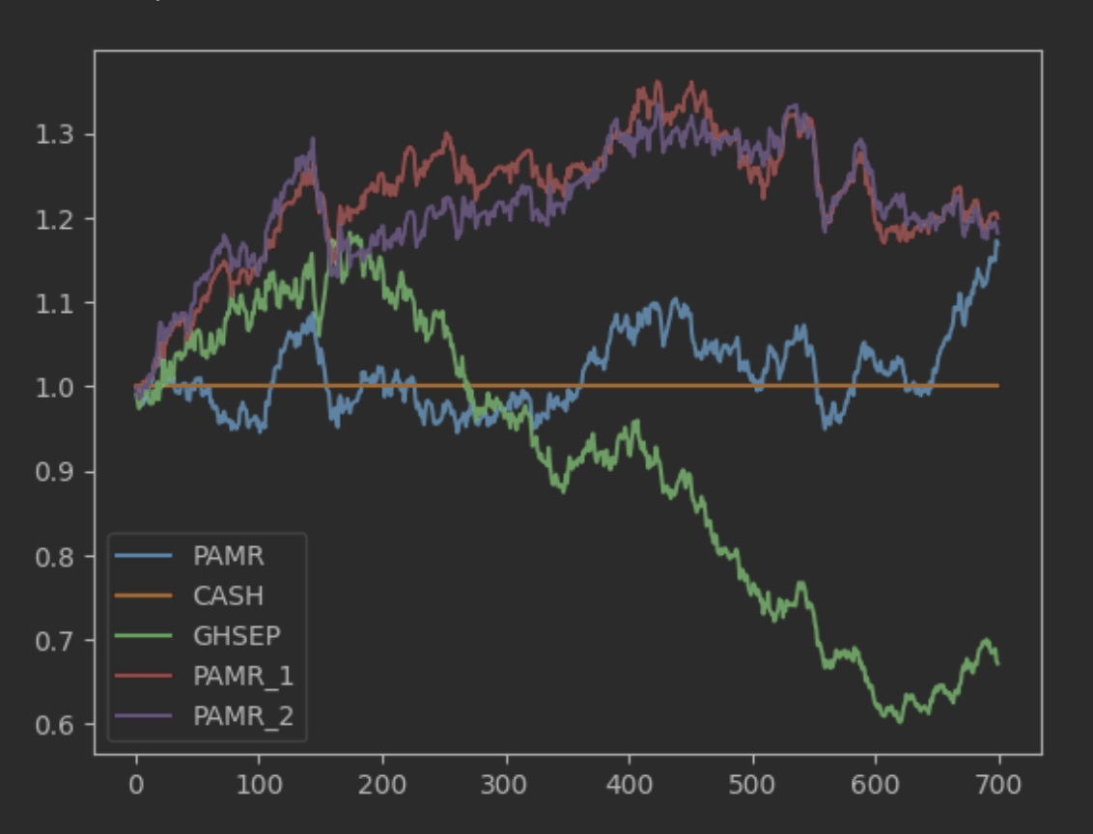
PAMR performance

Slide 21
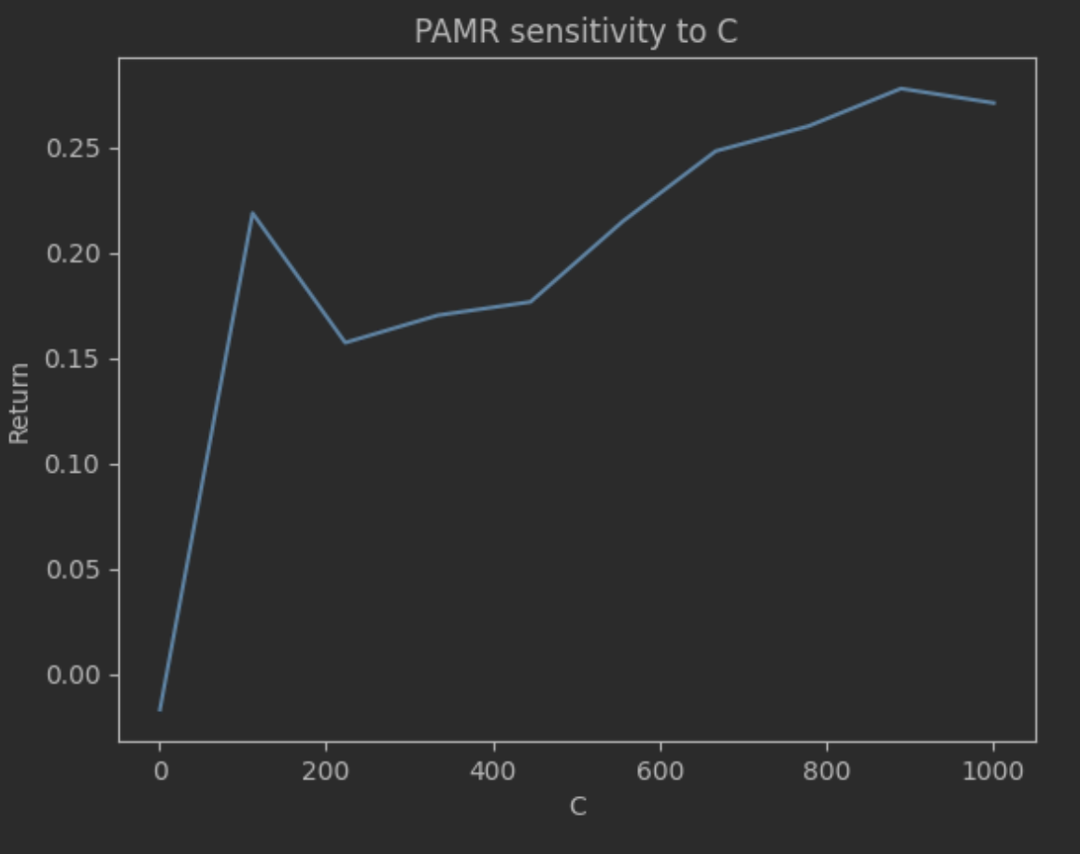
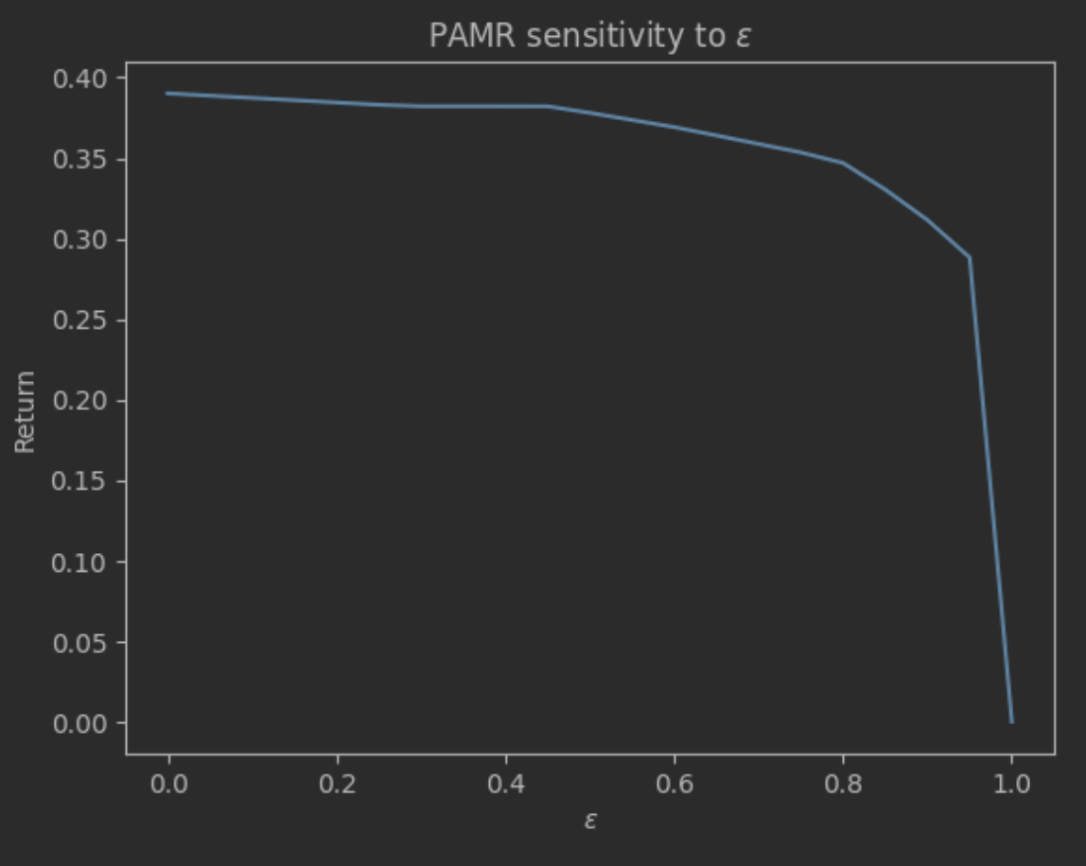
PAMR - Sensitivity Analysis
Algorithm has 2 parameters
ε - Loss threshold
C - Aggression Parameter

Slide 22
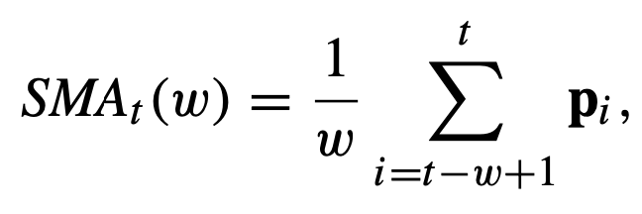
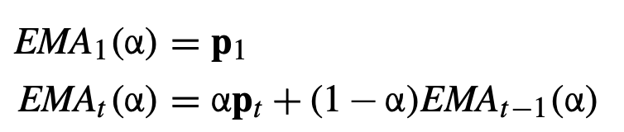
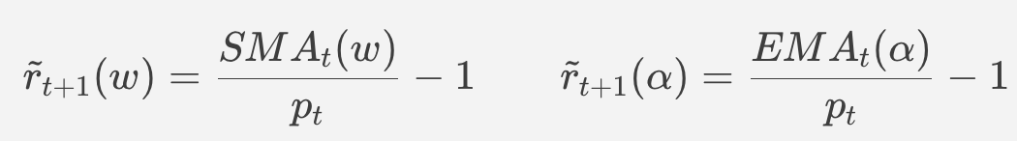

Online Moving Average Reversion
Incorporate multi-period mean reversion
Idea: The expected price in the next period is mean price over last periods
Implementation:
Select ε (Return threshold).
Initialise weights 1 in cash and 0 in other assets
For each time instant:
Find expected return
Determine portfolio which meets return threshold
Optimisation Problem
Notes:
Firstly, both algorithms suffer from frequently fluctuating raw prices, as they often contain a lot of noise. Secondly, their assumption of single-period mean reversion may not always be satisfied in the real world. Even two consecutive declining price relatives, which are common, can deactivate or fail both algorithms

Slide 23
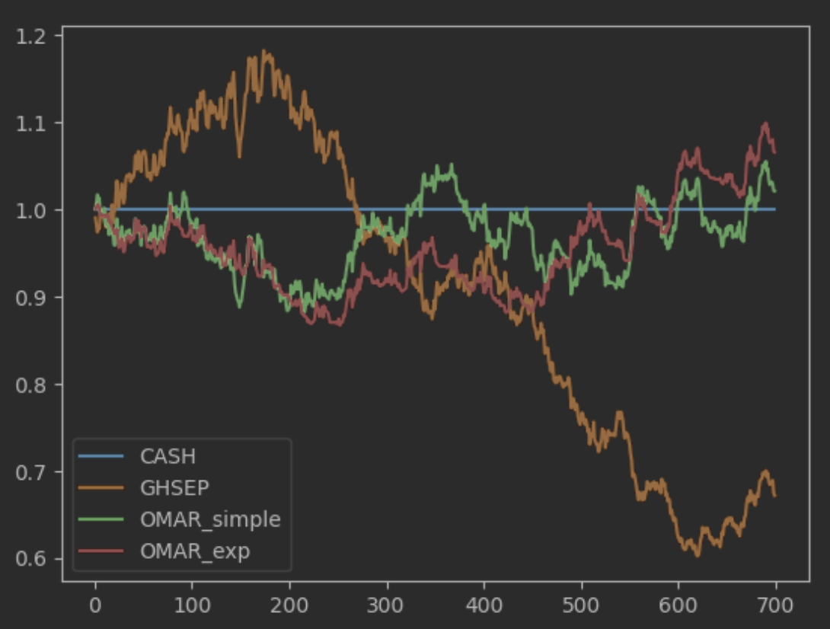
OLMAR performance

Slide 24
Backtesting
XLE | Energy Select Sector SPDR Fund
XLF | Financial Select Sector SPDR Fund
XLU | Utilities Select Sector SPDR Fund
XLI | Industrial Select Sector SPDR Fund
GDX | VanEck Gold Miners ETF
XLK | Technology Select Sector SPDR Fund
XLV | Health Care Select Sector SPDR Fund
XLY | Consumer Discretionary Select Sector SPDR Fund
XLP | Consumer Staples Select Sector SPDR Fund
XLB | Materials Select Sector SPDR Fund
XOP | Spdr S&P Oil & Gas Exploration & Production Etf
IYR | iShares U.S. Real Estate ETF
XHB | Spdr S&P Homebuilders Etf
ITB | iShares U.S. Home Construction ETF
VNQ | Vanguard Real Estate Index Fund ETF Shares
GDXJ | VanEck Junior Gold Miners ETF
IYE | iShares U.S. Energy ETF
OIH | VanEck Oil Services ETF
XME | SPDR S&P Metals & Mining ETF
XRT | Spdr S&P Retail Etf
SMH | VanEck Semiconductor ETF
IBB | iShares Biotechnology ETF
KBE | SPDR S&P Bank ETF
KRE | SPDR S&P Regional Banking ETF
XTL | SPDR S&P Telecom ETF
Universe: 25 Sector level ETFs + SPY
Time Period: 1 year (2022-04-11 to 2023-04-10)
Frequency: 1 minute
Performance Metrics
Sharpe Ratio
Win/Loss Ratio
Maximum Drawdown
Sortino Ratio
Calmar Ratio
Value at Risk
Treynor Ratio
Beta

Slide 25
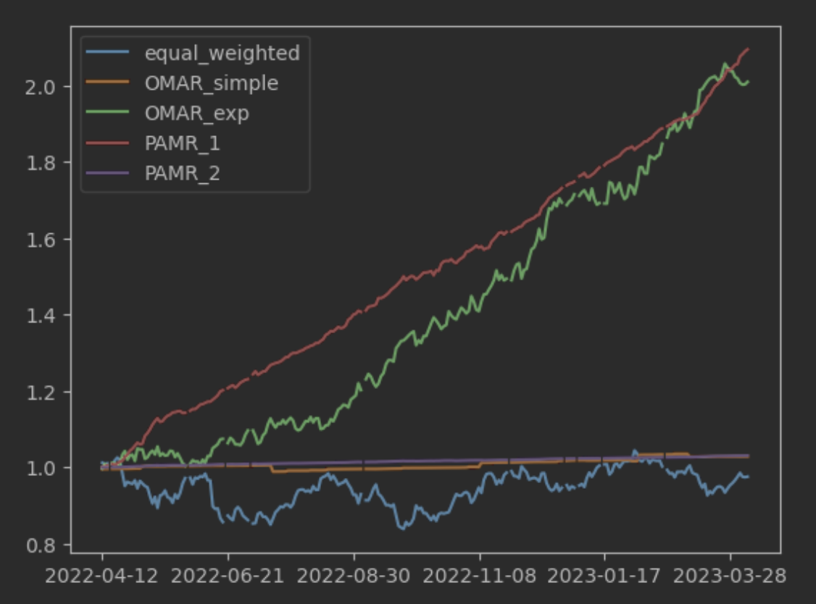
Comparison

Slide 26
Comparison
Strategy | Equal Weighted | OLMAR Simple | OLMAR Exponential | PAMR 1 | PAMR 2
Mean Return | 0.18% | 2.92% | 72.58% | 75.40% | 3.11%
Win % | 48% | 69% | 57% | 84% | 78%
Volatility | 0.2309 | 0.0283 | 0.1772 | 0.0548 | 0.0029
Sharpe ratio | 0.0078 | 1.0330 | 4.0963 | 13.7652 | 10.6724
Daily VAR | -0.0243 | -0.0002 | -0.0154 | -0.0035 | -0.0002
Daily CVAR | -0.0322 | -0.0026 | -0.0202 | -0.0057 | -0.0004
Drawdown | 0.1870 | 0.0168 | 0.0549 | 0.0112 | 0.0006
Cum Return | -2.42% | 2.88% | 100.97% | 109.47% | 3.10%
Calmar Ratio | 0.0096 | 1.7440 | 13.2167 | 67.5340 | 49.6971
Sortino Ratio | 0.0114 | 0.8010 | 7.1806 | 18.6560 | 13.0489

Slide 27
Practical Implementation
The algorithms assume that there are no transaction costs for trading. A proportional transaction cost can be introduced to address this.
We can incorporate margin by changing the optimization constraints.
The algorithm assumes that it is possible to instantly buy and sell any number and even a fractional number of stocks. This is reasonable for small capital and liquid stocks.
The model assumes that it does not cause any market impact. This assumption is acceptable as long as our wealth is not large enough to move the market.

Slide 28
Conclusion and Limitations
Online Portfolio Selection Algorithms are useful in algorithmic trading.
They automatically decide the trade by optimizing over portfolios.
FTL based portfolios come with theoretical regret guarantees, so they work on all markets.
Mean Reverting portfolios like PAMR work well on mean-reverting markets. But may not work in all markets.
Limitations
Makes ideal market assumptions
Regret is a weak benchmark. Can be improved to dynamic regret as well.

Slide 29
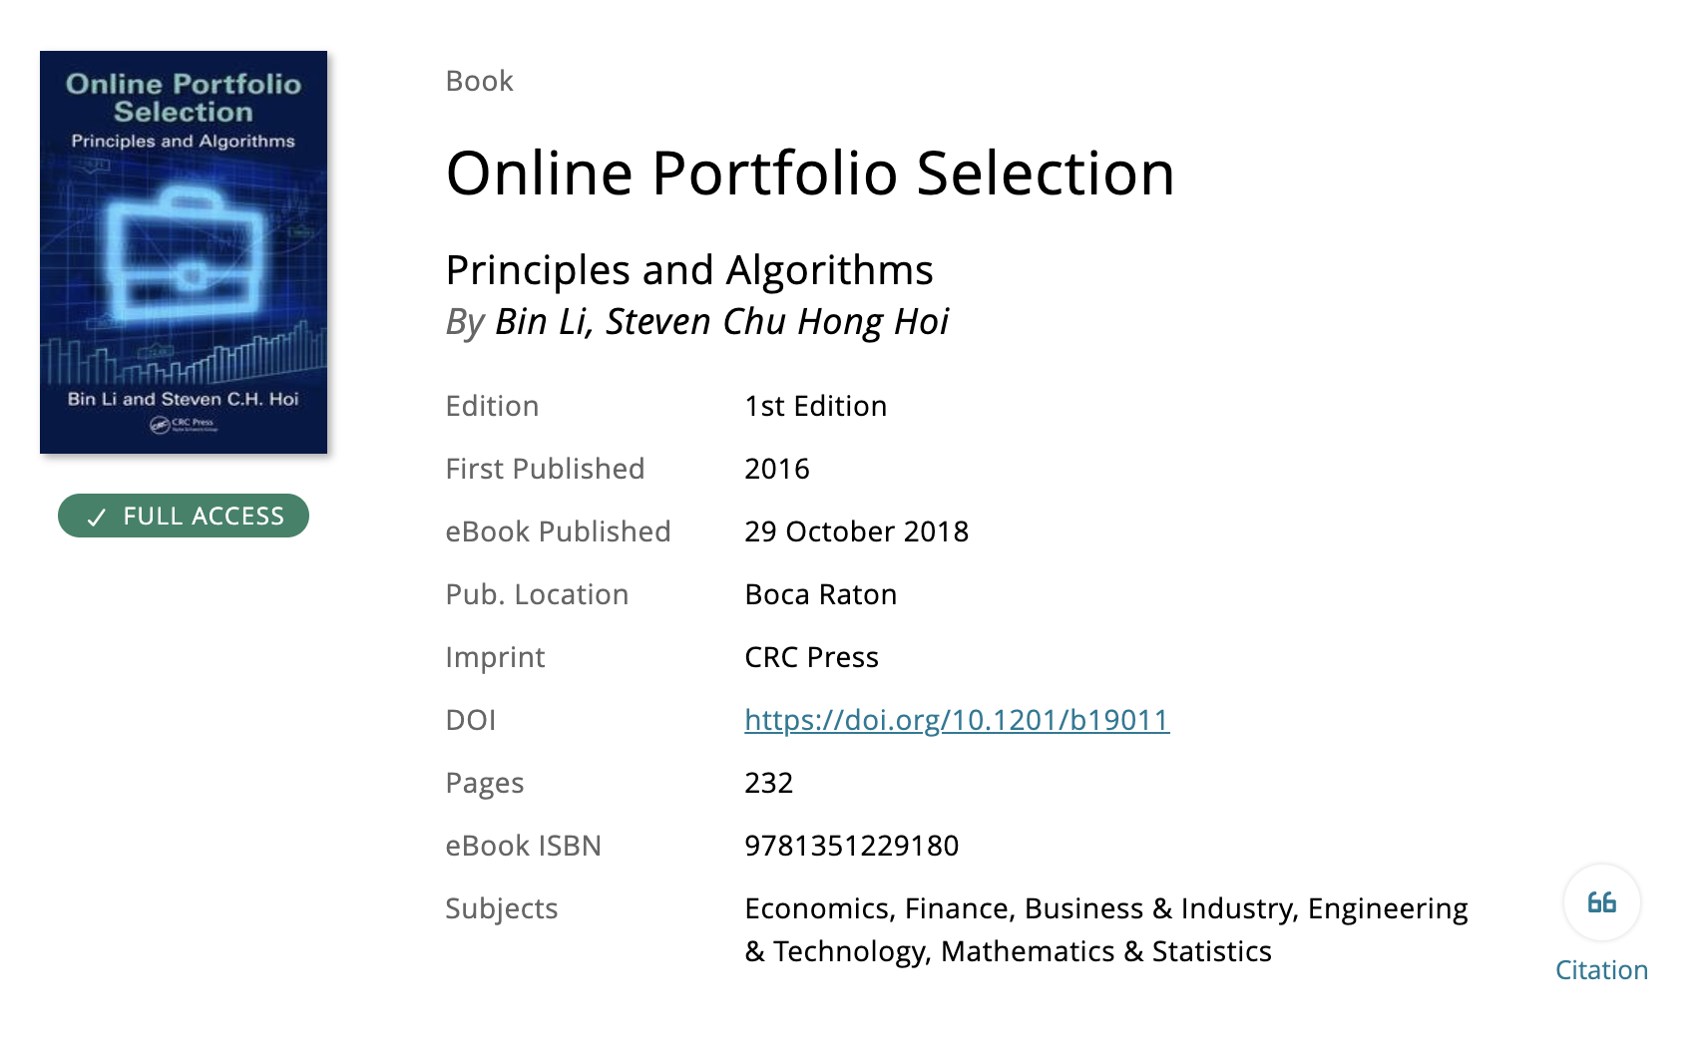
References

